Slide 1
Strategic Project Planning and Execution

Slide 2
Levels of Management
Strategic
Highest level of management
Tactical
Middle level
Operational
Day-to-day control

Slide 3
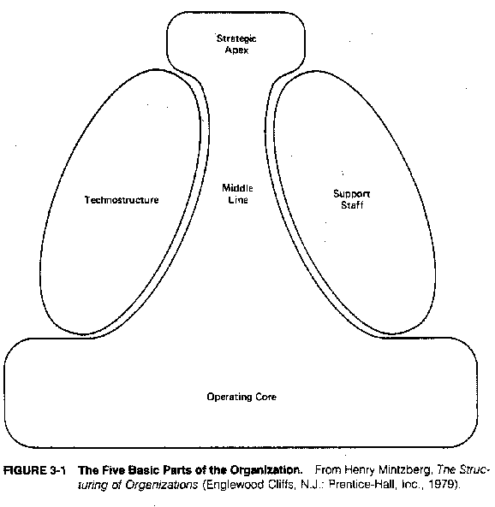
Mintzberg’s view of Organizations

Slide 4
Key parts of an organization
The strategic apex
Top management and its support staff
The operating core
The workers who actually carry out the organization’s tasks
The middle line
Middle and lower level management
The technostructure
Analysts such as engineers, accountants, planners, researchers and personnel managers
The support staff
The people who provide indirect services. These include maintenance, clerical, food service, transport, legal services and consulting to provide support

Slide 5
Strategic
Management
Tactical
Management
Operational
Management

Slide 6
Strategic
Strategic decisions deal with the big picture of your business. The focus of strategic decisions is typically external to the business and usually future oriented. Strategic decision-making creates the forward thrust in the business.
What business are you in?
What is your vision for the business?
What's your business' identity?
What do you stand for?
Which direction is the business headed?
How will the business compete?
Corporations often capture their overall business strategy in a "Statement of Intent”
Its about policy over the long term
Decision making is focused on unstructured problems, based mainly on data from outside of the organization.

Slide 7
Tactical
Tactical management involves making decisions about how an organization should go about achieving the overall objectives determined by strategic management.
Short- and medium-range plans, schedules, and budgets and specify the policies, procedures, and business objectives for their subunits of the company.
Decisions may be of an unstructured type, semi-structured or programmed type. But predominantly of a semi-structured type based on data from within and outside of the organization.

Slide 8
Operational
This management translates the goal of tactical management into daily operations
Decisions are predominantly of a programmed type based on data from within the organization.

Slide 9
Non programmed decisions
Decision Type
Programmed decisions
Operational
Tactical
Strategic
Management Level

Slide 10
Strategic Project Management Model
Defining the expectations and deliverables
Tactical project execution
Establishing the guidelines
Decision and alternative analysis
Strategic Project Planning
Defining the project scope and metrics
Problem and opportunity analysis
Organizing the project team
Situational review and assessment

Slide 11
Defining the expectations and deliverables
The strategic project management model begins with a definition of the expected project deliverables and expectations as defined through rigorous analysis and discussion with the customer or project sponsor.
Determines the scope of the project.
This does not define the project, only determines the intended output of the project

Slide 12
Establishing the guidelines
Developing the rules and guidelines that define the operational policies and procedures the project team will follow throughout the project’s duration.
A refinement of the project’s scope, along with a definition of the project performance metrics
Defining the project scope and metrics

Slide 13
Organizing the project team
Selecting the project team based upon the skill set required for the project.
While the project team is often preselected for the project manager by his/her executive management, responsibility for analysis and adjustment of the project team to meet unique project requirements remains with the project manager.

Slide 14
Situational review and assessment
An assessment of the project management environment to isolate the real and potential problems, issues, and opportunities the project team is likely to face during the project life cycle.
A critical element in the project planning cycle, situational analysis seeks to identify what is currently happening, what happened in the past that must now be dealt with, and what will likely happen in the future that could positively or negatively impact the project

Slide 15
Problem and opportunity analysis
Problems and issues identified during situational assessment are then addressed through structured problem analysis to determine the true root cause(s) behind those issues so that alternatives can be developed and assessed against the project objectives.
This, like situational assessment, is a part of risk management, focusing on identifying real and potential issues to be assessed and then addressed through contingency planning.

Slide 16
Decision and alternative analysis
Identify all alternatives available to the project team, determine their respective risks and costs, and then to quantitatively analyse each alternative against the project objectives. The alternative selected becomes the definition of the project. In essence, “how the project objectives will be met.”

Slide 17
Tactical project execution
Here the selected project alternative is detailed through development and execution tools like the work breakdown structure, cycle time modeling, PERT techniques and Gantt charts.
These become the tools used by the project management team to control and monitor the project, assess performance against established project objectives, and initiate corrective actions should a problem occur or a trade-off in one or more of the project variables become necessary.

Slide 18
Summary
Strategic project management is a structured methodology for analyzing and managing complex projects that are, or will likely be, impacted by a multitude of variables, constraints, and internal or external influences.
The secret to effective project planning is to utilize these tools to break down the project into several manageable, easy-to-understand-and-monitor subprojects or activities that can be effectively controlled by the project management team throughout the project’s duration.

Slide 19
Tactical Project Management Model
Development of Work breakdown structure
Trade off analyses
Activity listing detail
Gantt chart development
Tactical Project Planning
Dependency analyses
PERT critical path and slack (float) time analyses
Cycle time calculations
Calendar time conversion

